Slide 1
Chapter 15

Slide 2
Objectives

Slide 3
Objectives (cont.)

Slide 4
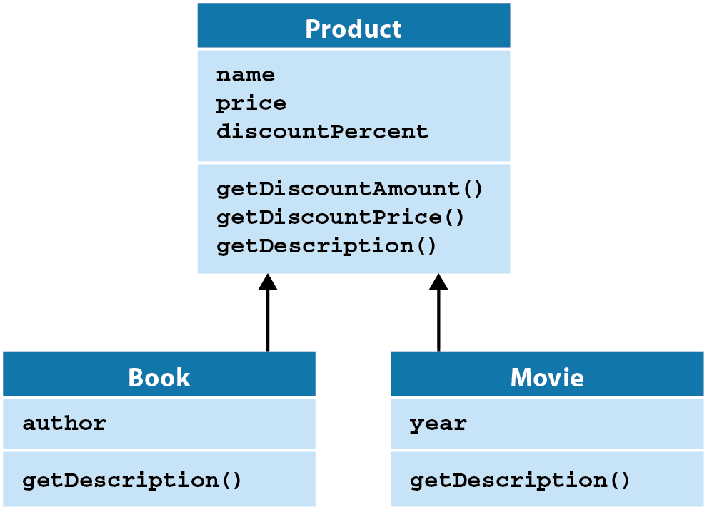
A UML diagram for three classes that use inheritance

Slide 5
UML diagramming note

Slide 6
The syntax for working with subclasses

Slide 7
The code for the Product superclass

Slide 8
The code for the Book subclass

Slide 9
When coding a subclass…

Slide 10
Three versions of the getDescription() method

Slide 11
Code that uses the overridden methods

Slide 12
A function for checking an object’s type

Slide 13
Code that uses the isinstance() method

Slide 14
The console

Slide 15
The objects module

Slide 16
The objects module (cont.)

Slide 17
The user interface for the Product Viewer

Slide 18
The product_viewer module

Slide 19
The product_viewer module (cont.)

Slide 20
The product_viewer module (cont.)

Slide 21
A method of the object class

Slide 22
The syntax for overriding the __str__() method

Slide 23
Two more methods of the object class

Slide 24
The constructor for a Dice class

Slide 25
A Dice object that contains five Die objects

Slide 26
The dice module

Slide 27
The dice module (cont.)

Slide 28
The hierarchy for six common exceptions

Slide 29
The syntax for creating your own exceptions

Slide 30
A module that uses the DataAccessError class

Slide 31
Code that handles a custom exception

Slide 32
It makes sense to use inheritance when…

Slide 33
A Dice class that inherits the list class (not recommended)

Slide 34
A few of the problems with this approach

